Slide 1

Customer Churn Analysis – Project Report
Data-Driven Retention Strategy & Action Plan
Prepared By: Krushnal Patil
Date: February 2026
Version: 1.0 – Final

Slide 2
Executive Summary
6,418
~2,000
411
27%
Total Customers
Total Churned
New Joiners
Overall Churn Rate
(Telecom benchmark: 15–20%)
Top 3 Themes for Churn
1. Competitor Advantage
2. Attitude Failures
3. Dissatisfaction
761 customers (43.9%)
301 customers (17.4%)
~300 customers (~17.3%)
Opportunity: Reducing churn by 5pp retains ~320 customers annually (~₹2.4M revenue).

Slide 3
Introduction & Objectives
Background
Objectives
Our churn rate of 27% exceeds the industry benchmark of 15–20%. Retention is cost-effective compared to acquisition (5–7x cheaper).
Identify segments with highest churn
Quantify root causes
Profile predicted churners
Provide actionable recommendations
Scope
Consumer segment, post-paid plans, last 12 months churn, Power BI dashboard data.

Slide 4
Methodology
Analytical Approach
01
02
Data extraction & validation
Exploratory data analysis
(Power Query)
(Power BI)
03
04
Segmentation & predictive profiling
Insight synthesis
Data Sources
Customer Master Database: 6,418
Churn Transaction Log: ~2,000
Churn Reason Transcripts: 1,732
Predicted Churner Model Output: 366
Churn Reason Coding Framework
Competitor, Attitude, Dissatisfaction, Price, Service Gaps, Other

Slide 5

Key Findings – Who Is Leaving
Overall Churn Rate
27% (~2,000 customers)
Churn by Age Group
24–27% across all ages
Churn by Tenure
26–27% across all tenure groups
Gender Analysis
Female overrepresented (64% of predicted churners)
Geography
High churn in J&K, Assam, Jharkhand

Slide 6
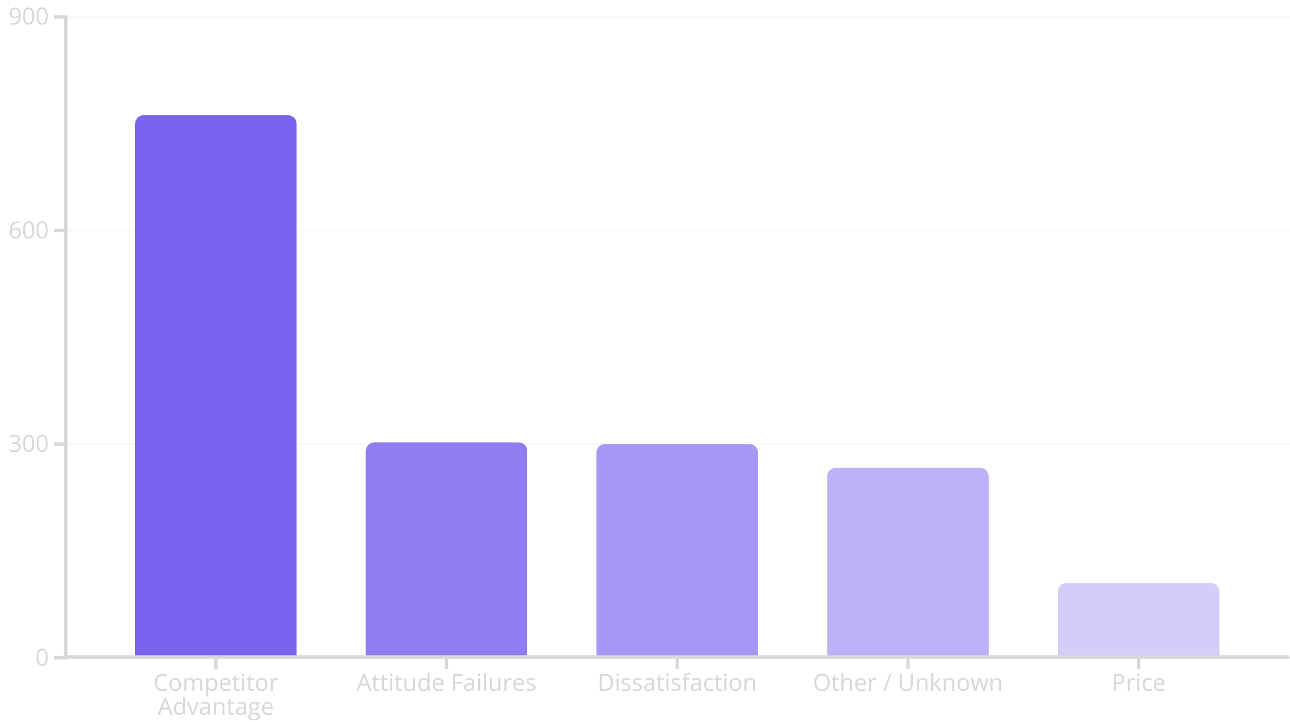
Key Findings – Why They Leave
Top Churn Reasons
Insights
Product & device gaps are critical
Attitude failures are preventable
Price is rarely sole reason

Slide 7

Geographic & Regional Analysis
Top 5 States Churn Rate
57%
38%
35%
Jammu & Kashmir
Assam
Jharkhand
31%
30%
Chhattisgarh
Delhi
Action: Dedicated state-level diagnostic & retention plan

Slide 8
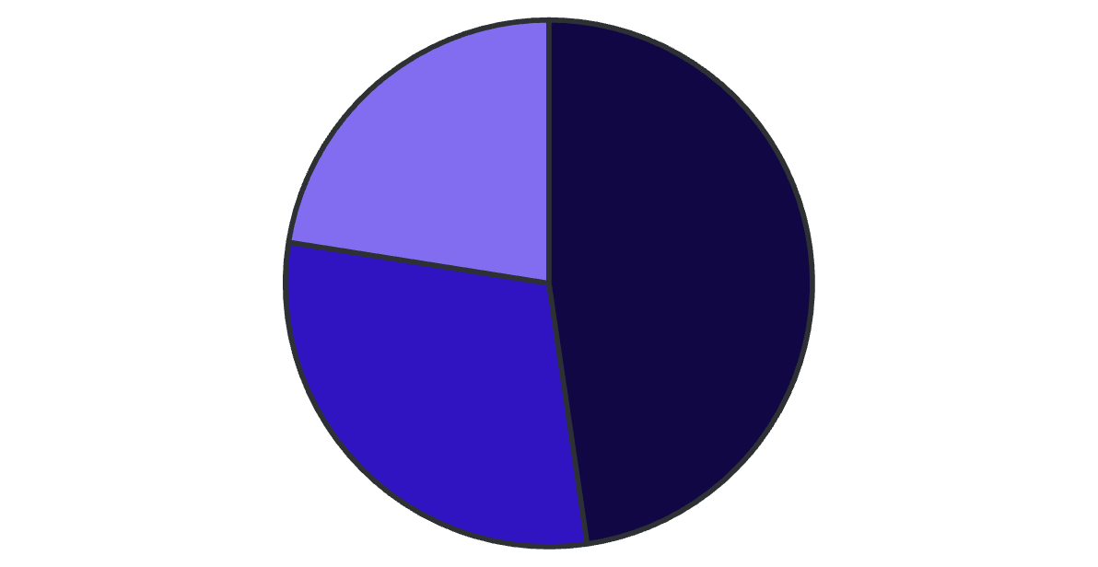
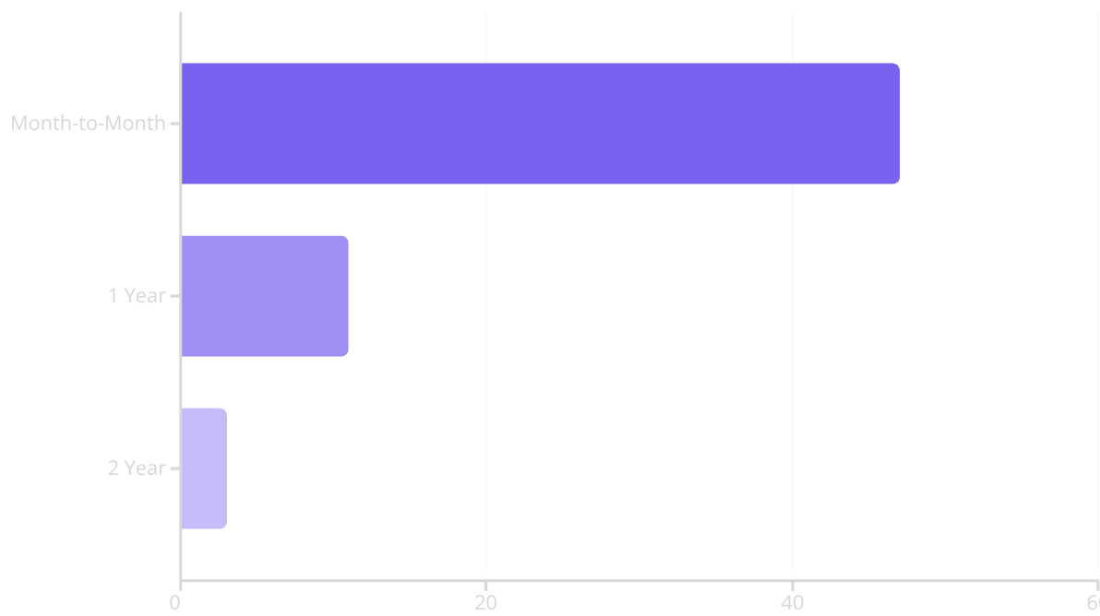
Service & Product Analysis and Contract & Payment Behaviour
Churn by Internet Type
Churn by Contract
Fiber Optic
Cable
DSL
Service Adoption
Churn by Payment Method
Online Security 15.4%
Premium Support 16.5%
Mailed Check – 38%
Bank Withdrawal – 34%
Credit Card – 15%
Retention Gap: Low adoption of retention-driving services
Insight: Reduce friction and incentivise commitment and digital payments.

Slide 9
Recommendations & Action Plan and Implementation Roadmap
Priority
🔴 Critical (7 days)
🟡 High (30 days)
🟢 Medium (3–6 months)
Key Actions
1
2
3
4
Contact predicted churners
Device audits
Support retraining
Exit surveys
5
6
7
State-specific campaigns
Service adoption increase
Contract conversion incentives
90-Day Plan
Week 1–4
Week 9–12
Emergency response, quick wins, pilot launches
Sustain & close quarter
1
2
3
Week 5–8
Scale & measure
Ownership Matrix
Product, Customer Service, Marketing, Commercial, Digital, Analytics, Regional Operations
Success Metrics
Predicted churner save rate 20%
Online Security & Premium Support 25%
Month-to-Month contract conversion 15%

Slide 10



Conclusion and Next Steps
Key Findings
208 customers
289 customers
80 customers
366 predicted churners
lost due to attitude
lost due to device gaps
lost with unknown reasons
at risk
Choice
Maintain course
Quick fixes
Systemic transformation
(27% churn)
(8–12pp churn reduction, ₹2.4M revenue preserved)
Limitations
Data: Prediction methodology, ambiguous churn responses, competitor pricing, feedback linkage
Scope: Enterprise/pre-paid excluded, churn >12 months excluded
Confidence: High for competitor & attitude, moderate for dissatisfaction, low for price sensitivity
Appendix
Glossary, Dashboard Screenshot Guide, Predicted Churners Data Sample, DAX Measures, Churn Reason Coding Schema, References & Benchmarks

Slide 11
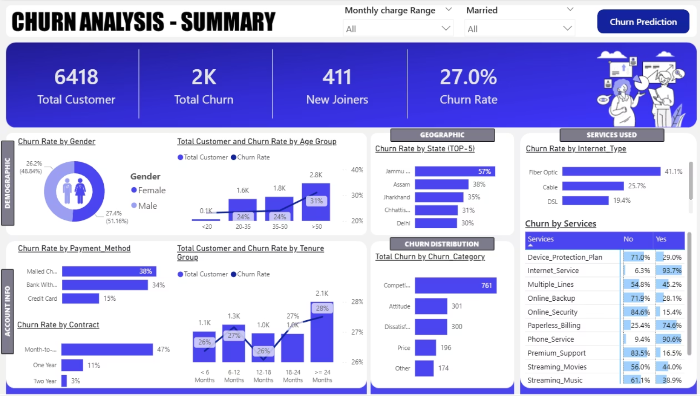
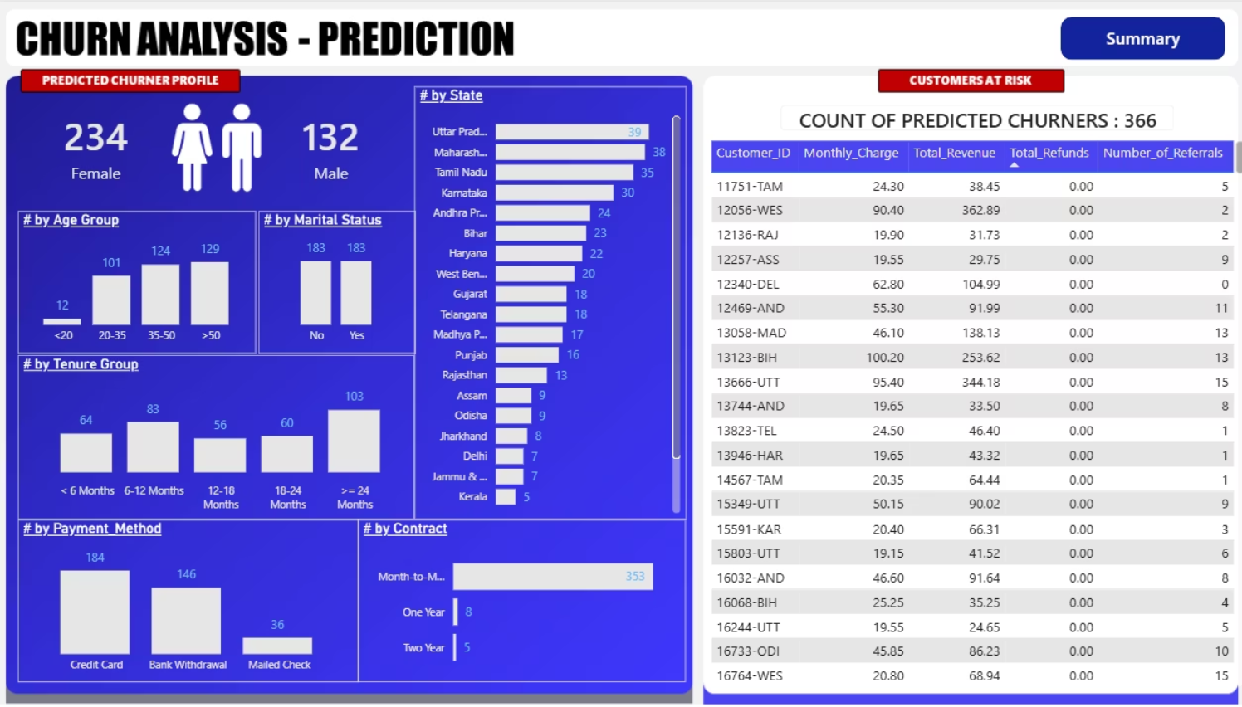
Dashboard Screenshots
To complement this report and enable continuous monitoring, a series of interactive dashboards have been developed in Power BI. These dashboards serve as living tools for tracking key performance indicators related to customer churn, visualizing trends, and drilling down into specific segments and reasons for attrition. They provide real-time insights that empower various teams—from customer service to marketing and product development—to proactively address churn risks and evaluate the effectiveness of retention initiatives.
The dashboards allow for granular analysis of customer demographics, service usage patterns, contractual obligations, and payment behaviors. They dynamically present data on predicted churners, highlight geographic hotspots, and offer detailed breakdowns of churn reasons, facilitating a data-driven approach to strategy formulation and operational adjustments. Regular review of these dashboards is crucial for maintaining a responsive and effective customer retention program.

